Slide 1
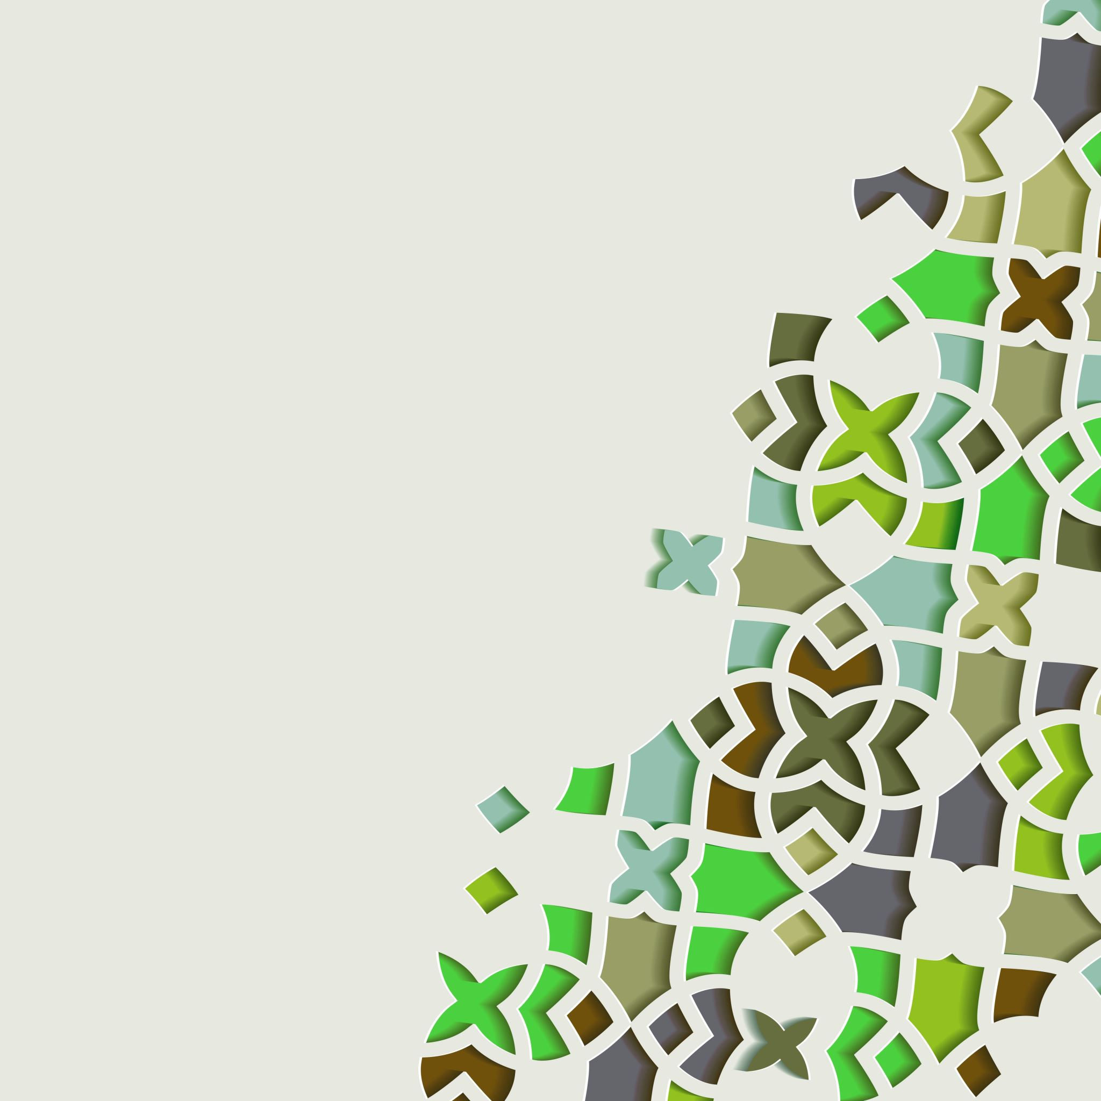

Auto Layout and Responsive UIs
2022/3/20

Slide 2
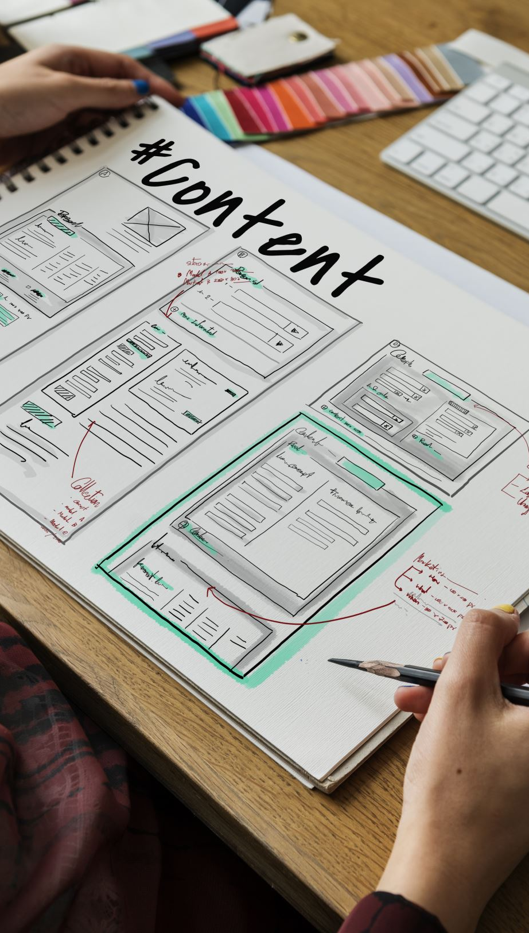
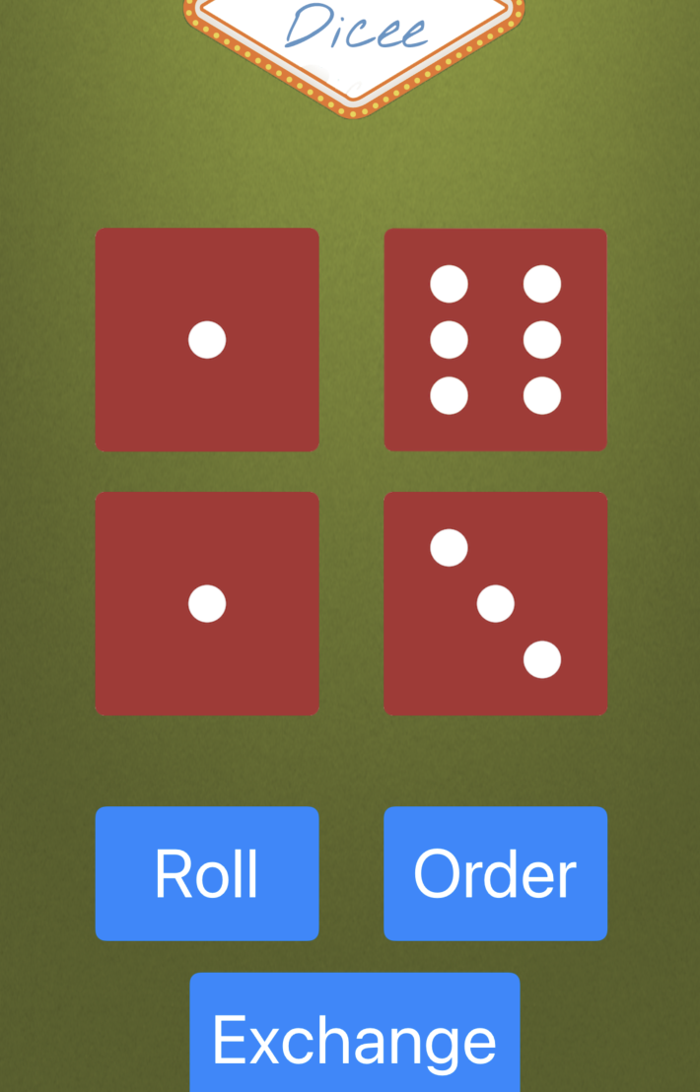
We have done the first “touchable” app in previous lessons, and you can get your creativity!

Slide 3
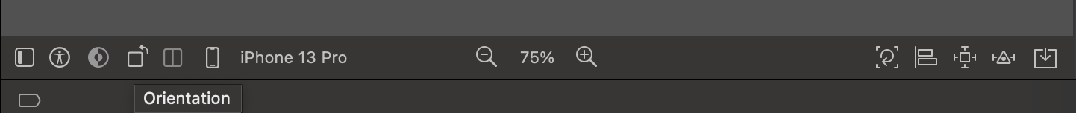
But there is a big problem once you see my iPhone or click the orientation button on your Xcode…
Click the Orientation Button

Slide 4
So Today‘s lesson is about how to make your app look beautiful on “all” screen sizes and orientations!

Slide 5
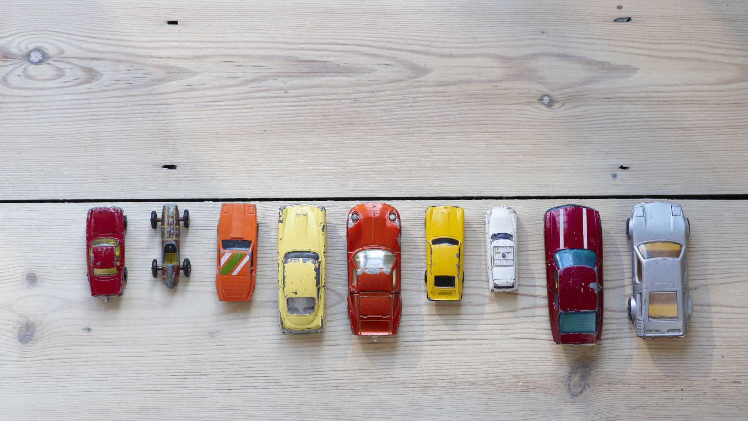
Auto Layout

Slide 6
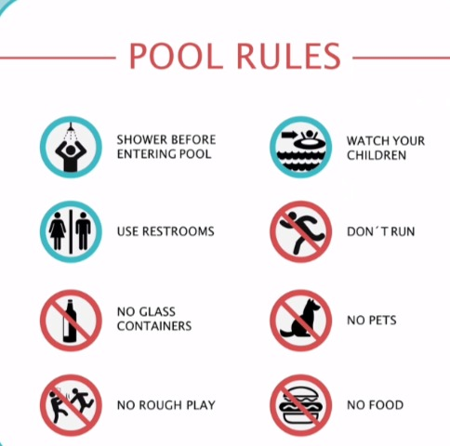
Layout Rules
The Layout rules allow the iPhone to figure out how to layout each element as it gets rendered on a different screen of a different aspect ratio or size.

Slide 7
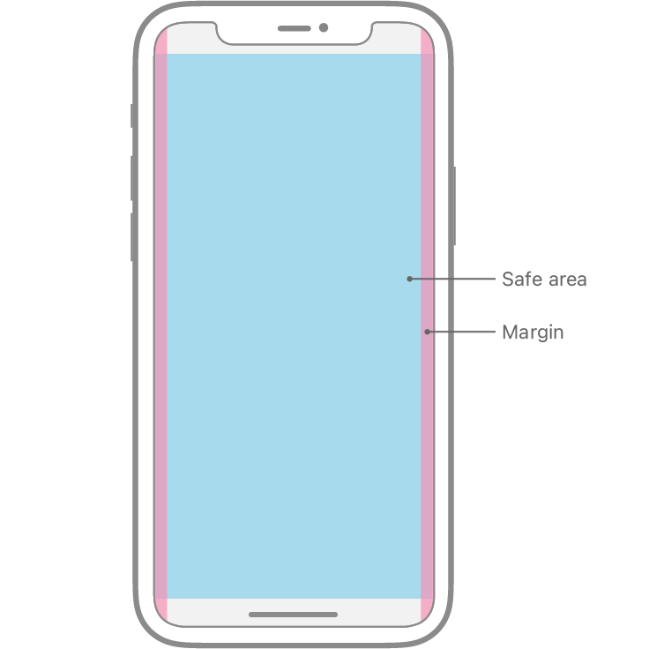
Layout Rules
https://developer.apple.com/design/human-interface-guidelines/ios/visual-design/adaptivity-and-layout/

Slide 8
Layout Rules
Button1
Button2
Button3

Slide 9
Layout Rules
Button1
Button2
Button3

Slide 10
Layout Rules
Button1
Button2
Button3

Slide 11
Layout Rules
Button1
Button2
Button3

Slide 12

In his lesson we will learn about…
Size Classes and Orientation
Understand Constraints
Alignment and Pinning
Use Containers for Finer Grained Control
StackViews

Slide 13
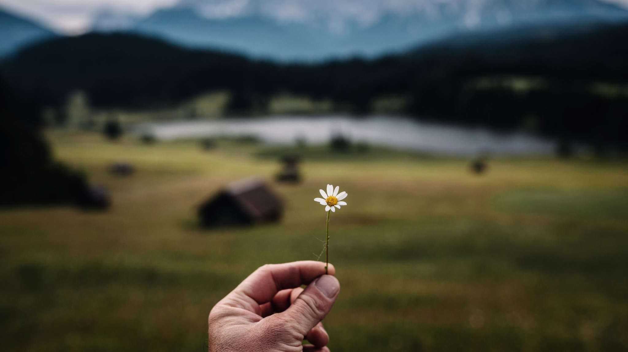
Let’s Begin with Our First App…

Slide 14
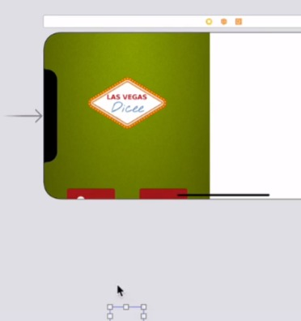
Recreate The Layout Issue
If we orientate the phone into landscape, then you can see that that Button has completely disappeared, and there's no way for the user to interact with our app anymore.

Slide 15
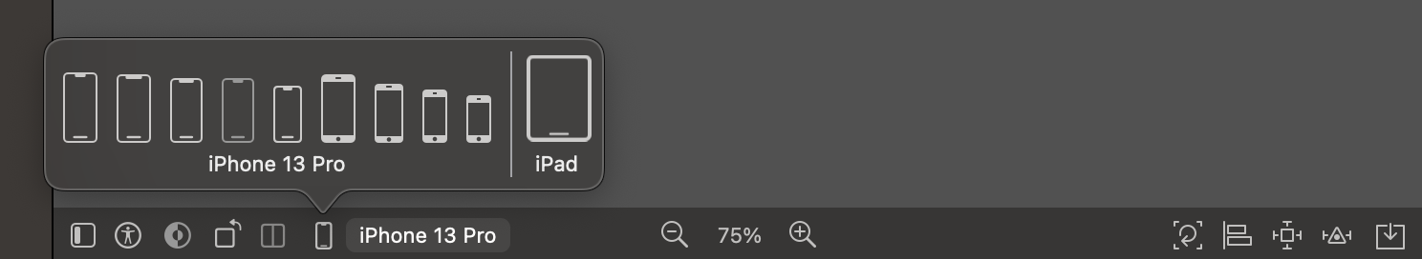
Check The Size Classes and Orientation

Slide 16
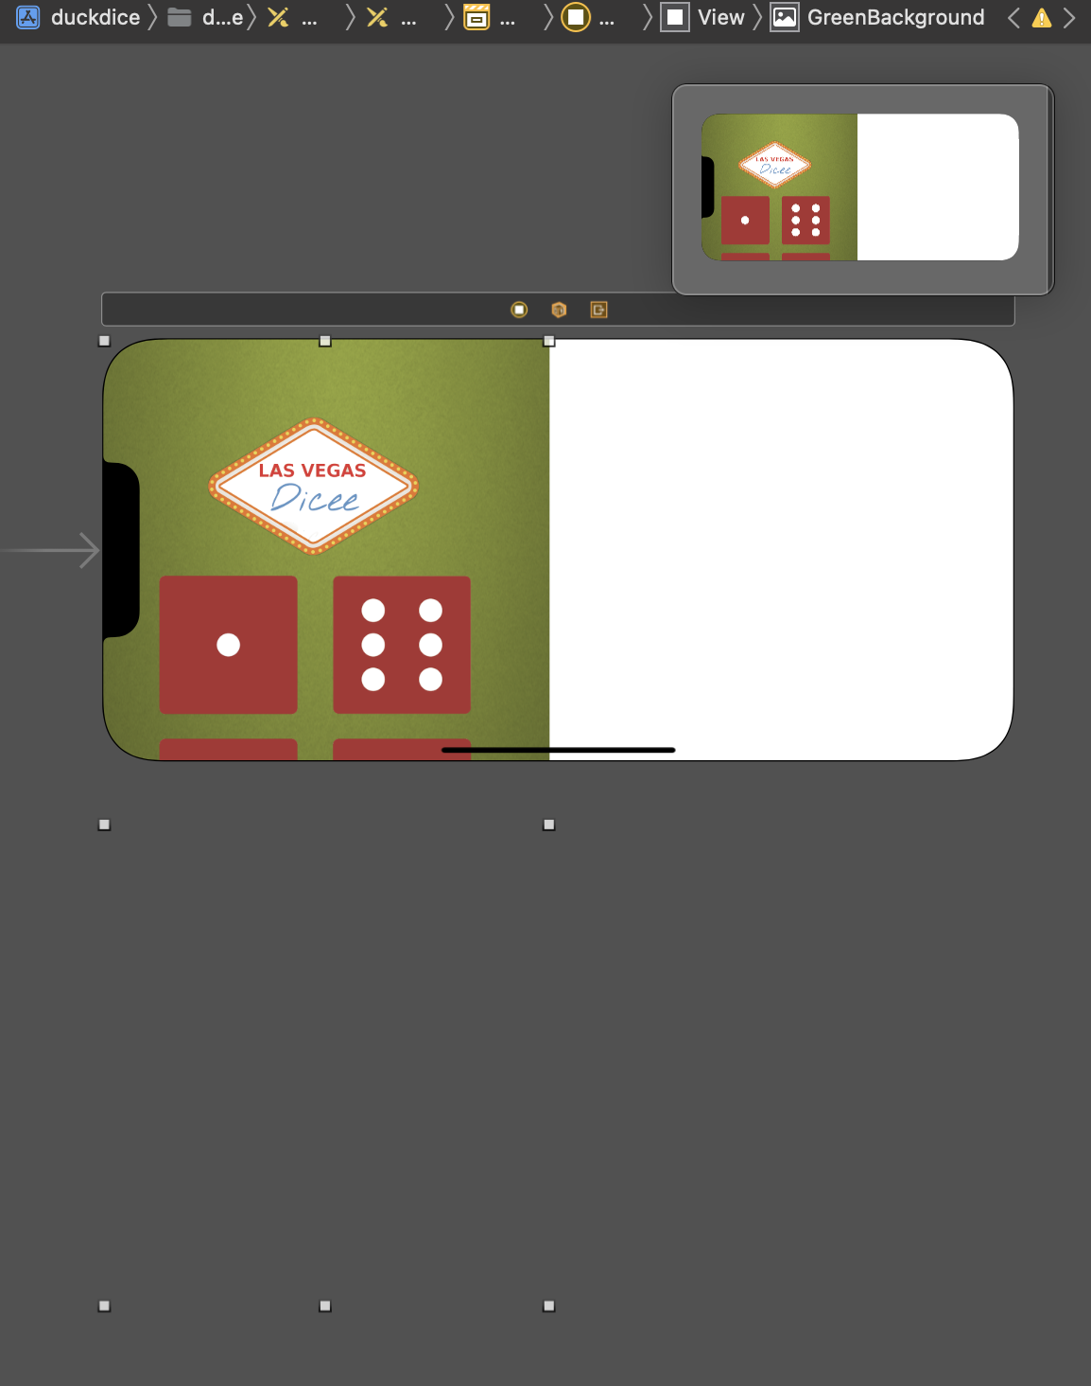
How to Solve The Issue?
First, we see the image view as background in our app…
You may want to modified the ratio of the image view, but it is not the way…
We need to add some rules or Constraints onto this image view.

Slide 17
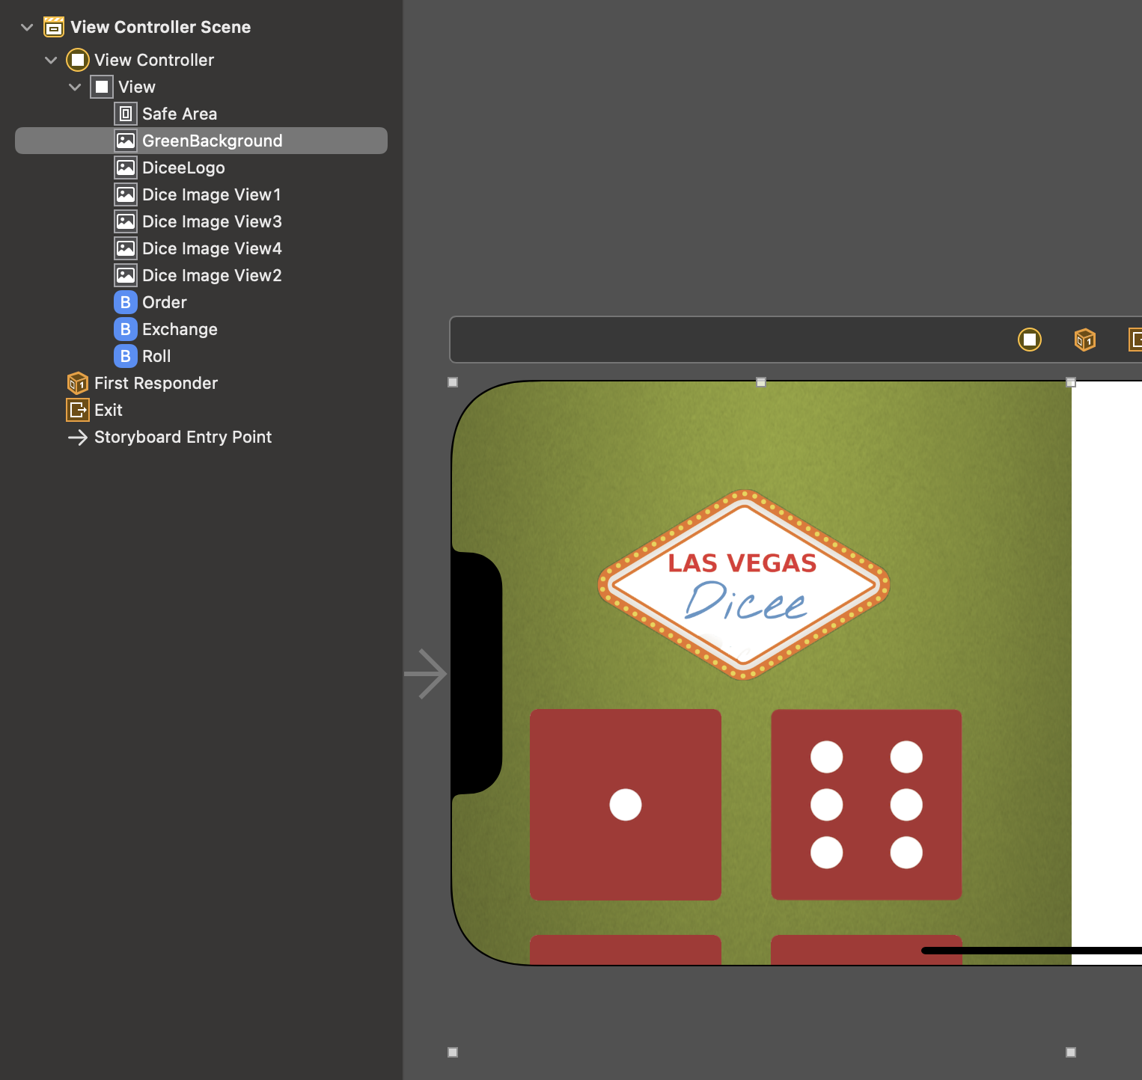
Constraints
We need to add some constraints to our “GreenBackground”, so that even when it's in landscape or on a different device, it still is touching all four sides of the phone and it's stretching to fit the entire screen

Slide 18
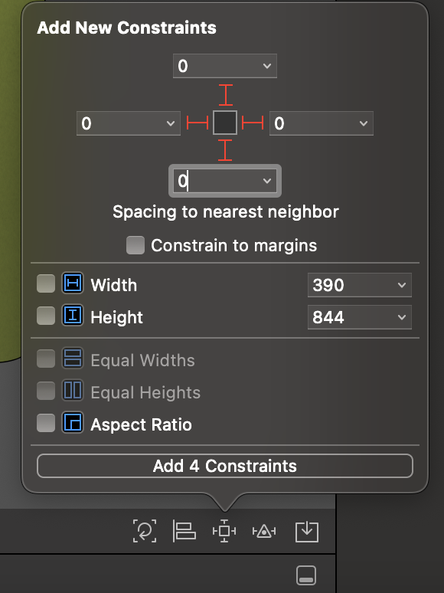
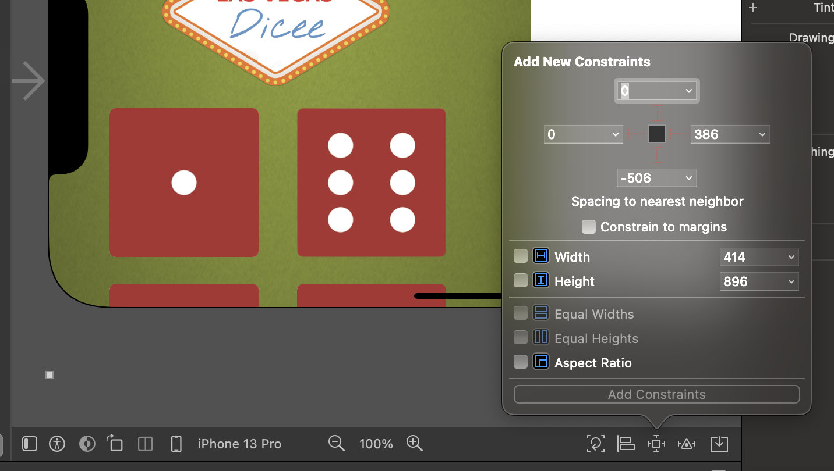
Add New Constraints
2.Set All The Distance to 0
The little square button allows us to add a Constraint.
The Constraint can specify a zero-pixel distance from the top of the phone, zero from the left, zero from the right, and zero from the bottom.
1.Add Constraints

Slide 19
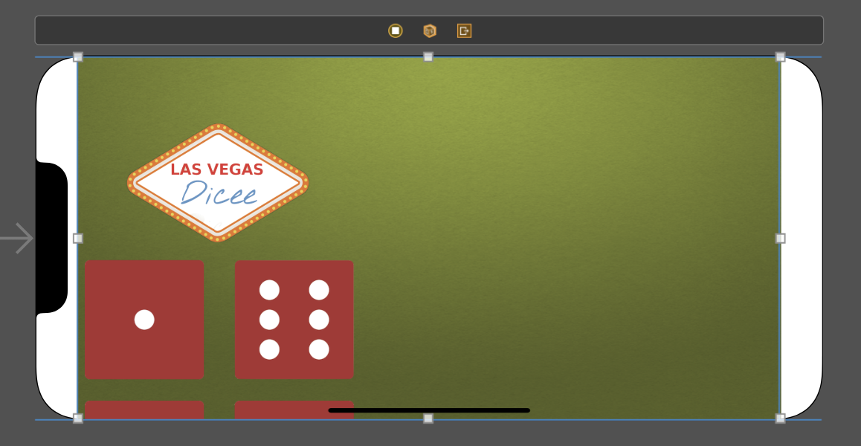
The Background Looks Better…
But there's a couple of problems here.
Firstly, why the background is not going all the way to the left and right? What's going on there?

Slide 20
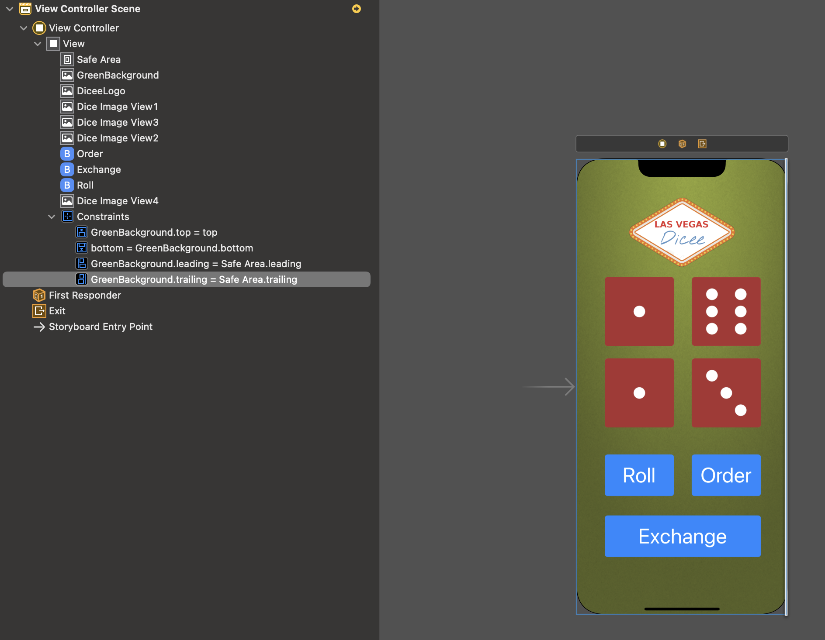
How to See Constraints and Rules?
We can see what these constraints or rules are doing to the user interface.
The rule says the right side, or the trailing side should be equal to the safe areas trailing.
This means that when our phone goes into landscape, the safe area is the area which normally contains either the battery information or the signal information of the phone.
At the bottom of the iPhone 13 Pro, it's the home button essentially, it's the part which you swipe to go back to the home area.

Slide 21
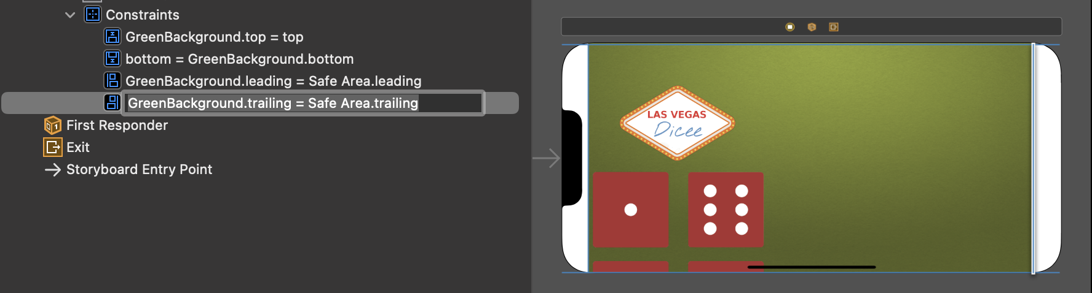
Is It safe?
If we're creating an app that has buttons on it, then we don't want it to be in these safe areas, so we'll define rules that keeps it out of these areas.
But in this case, it's just a background, we want our background to cover the entire screen, we don't want it to be set to the safe areas trailing, in fact, we want it to be set to the superview.

Slide 22
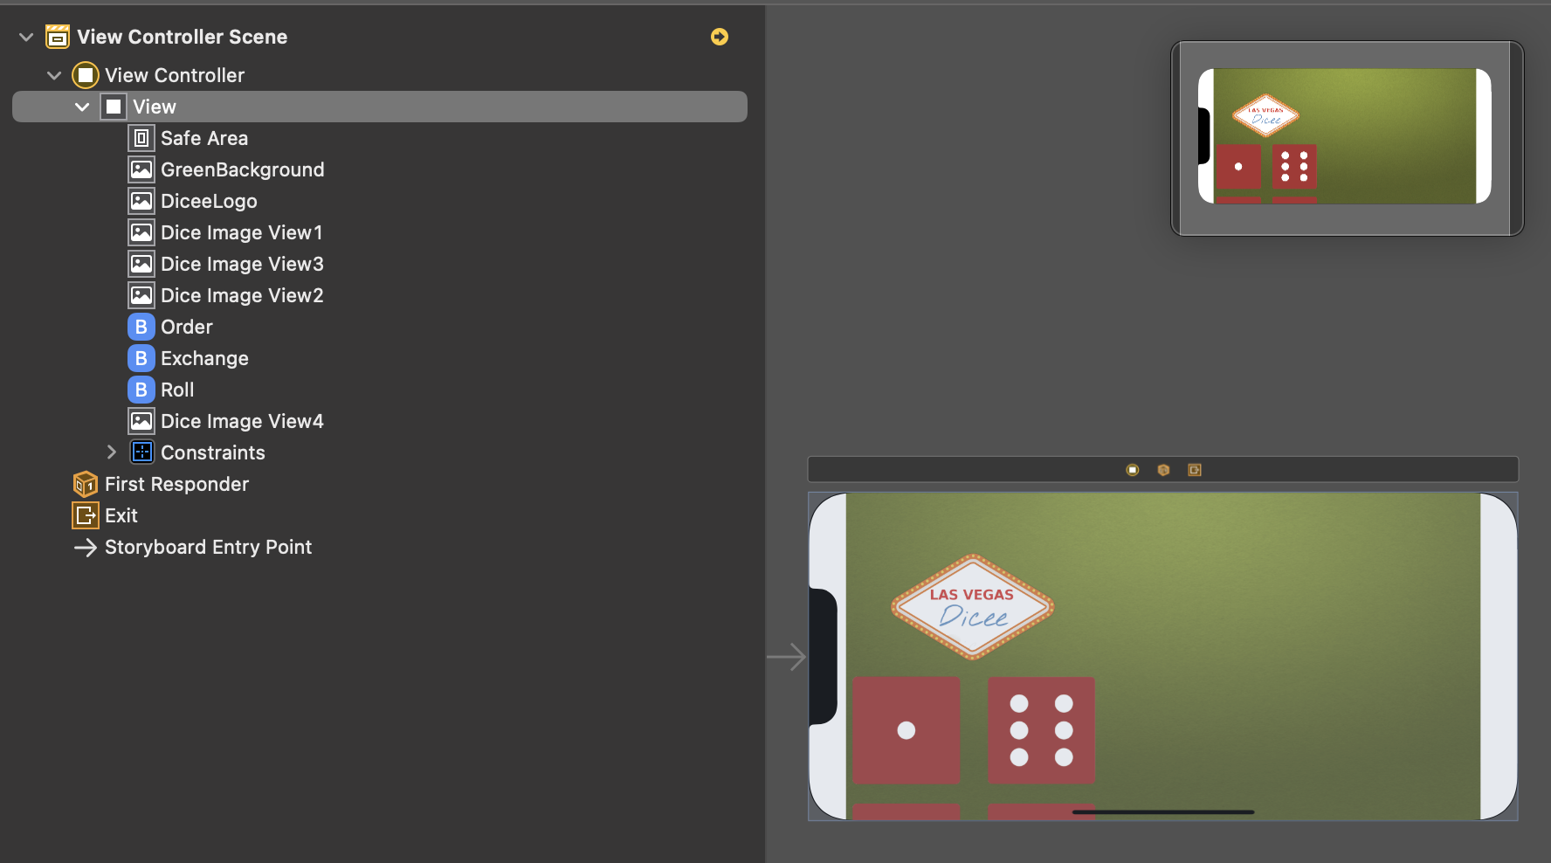
Superview
The superview that's at the base of our View Controller is always going to be covering the entire screen.
If we want to define this constraint, rather than relative to the safe area, we're going to define it to the superview.

Slide 23
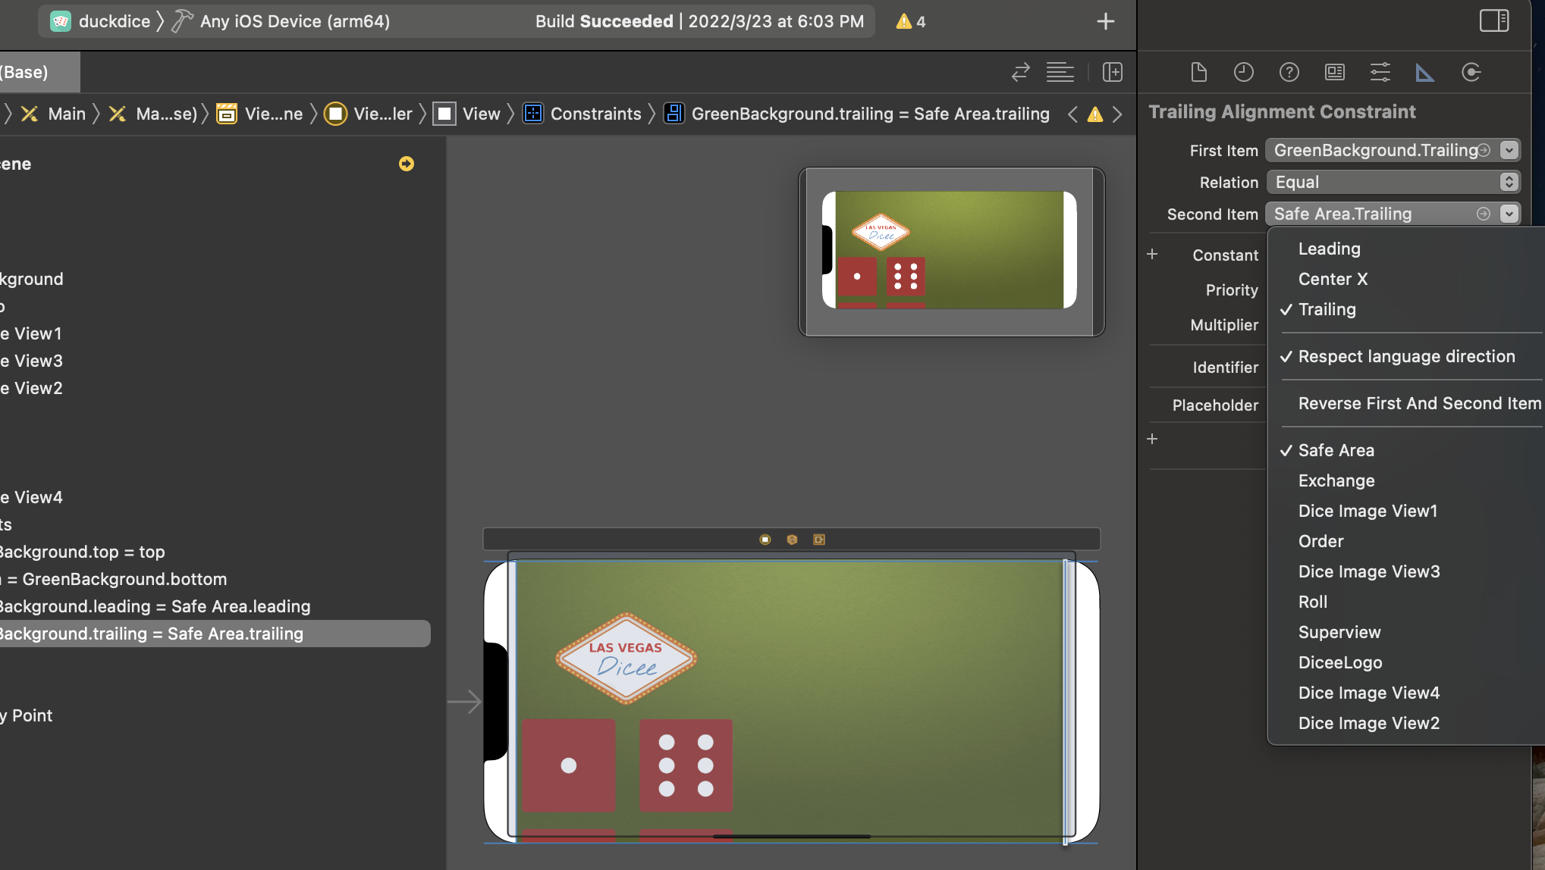
Set The Suitable Constraints
Set the trailing from safe area to the superview, and when we go into landscape, you can see that it looks perfect as it is.
you can see each of these rules when you click on them, and you can view them in more detail in the attribute pane.
Also, you can see the rules that have been set up here that set the Constraint between a first item and a second item and the relationship between them.

Slide 24
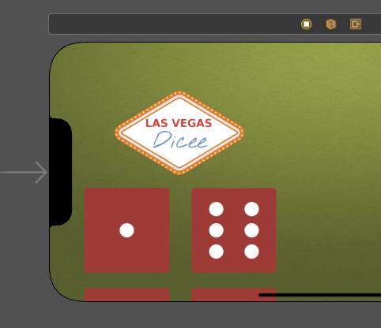
But How About Other ImageView and Buttons?

Slide 25
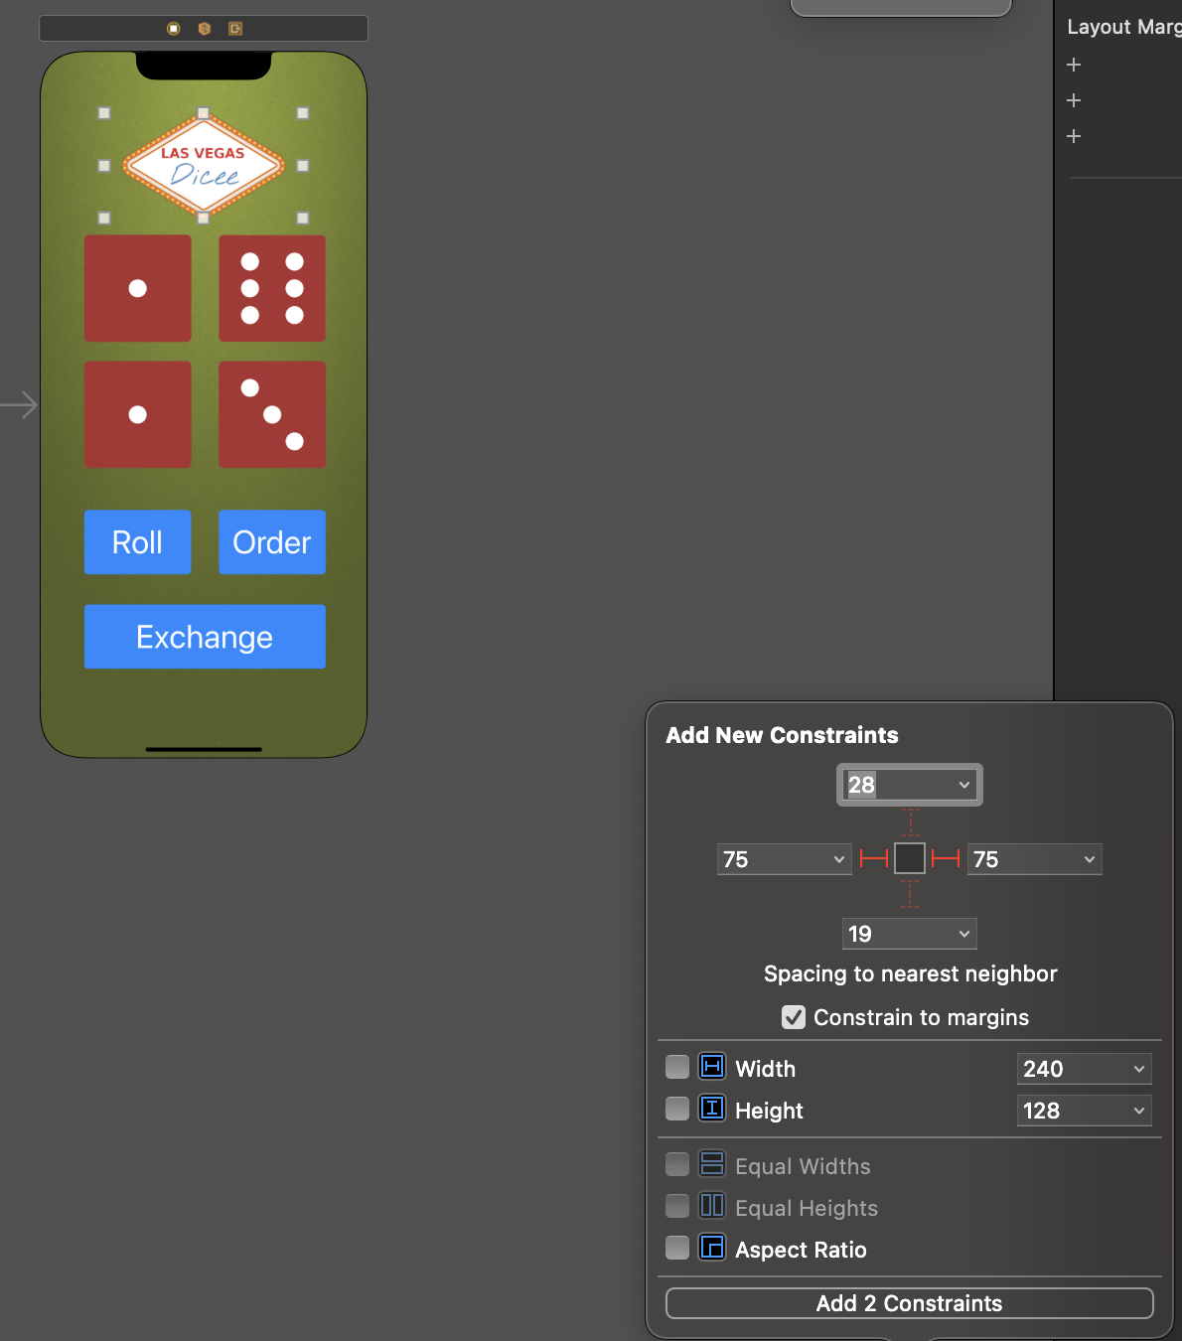
Pinning to The Edges
If we want to bring an item to the middle, we have two options.
We could simply do what we learned before, we can select the item and add the Constraints, so that it's pinned to the edges of the superview.
But this is not going to look very good.

Slide 26
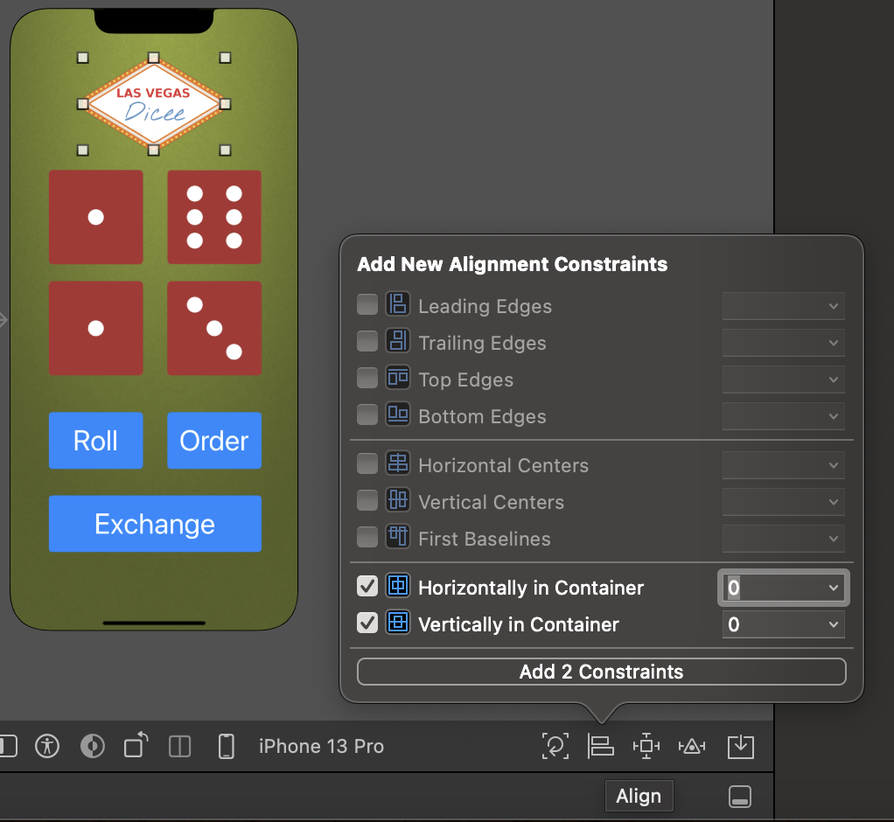
Alignment
Instead, let's go ahead and click on the alignment button here and align it to be horizontally in the container and vertically in the container.
So, let's add those two constraints, And now when we turn to landscape, you can see it works just perfect.

Slide 27
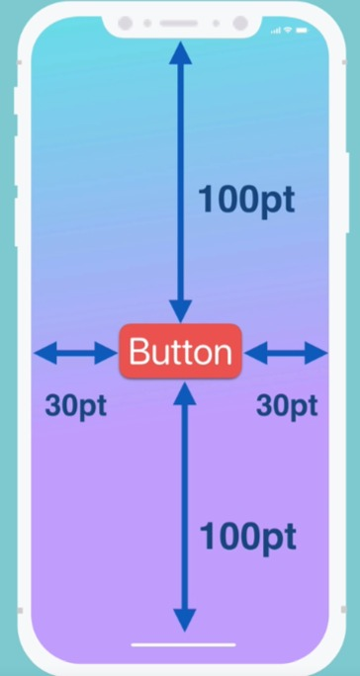
Pinning and Alignment
When we think about adding constraints, we can think about it in terms of pinning where we add these constraints that define the distance between our element and the containing view.

Slide 28
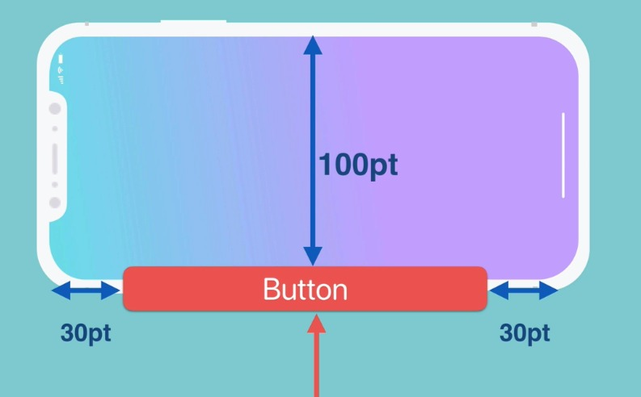
Pinning and Alignment
When we turn our phone, in this case, the landscape, it'll try to fit it still to the edges.
Of course, some of these will have to break because we can no longer afford 100 pixels,in this case from the top and 100 pixels from the bottom. There isn't that amount of vertical space anymore.

Slide 29
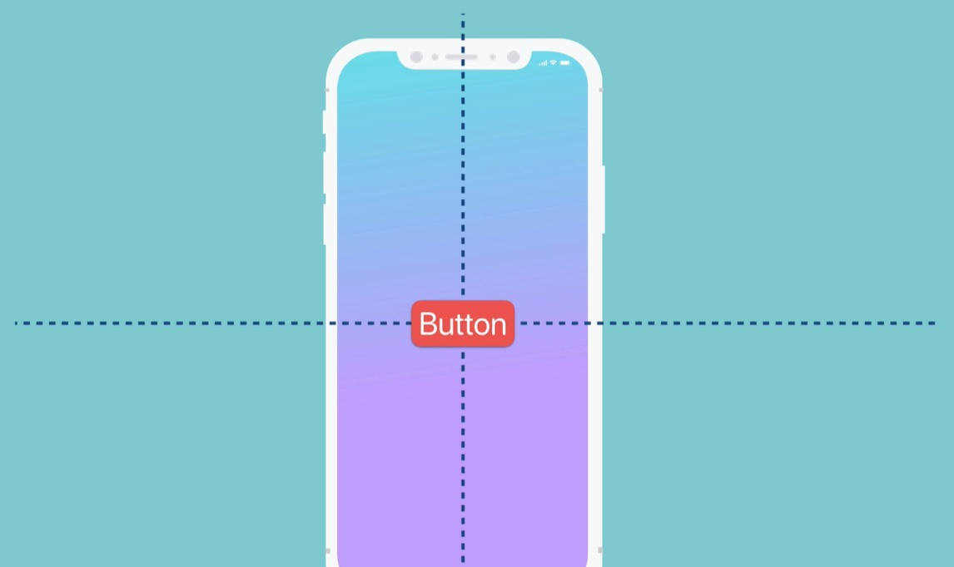
Pinning and Alignment
the alignment technique where we say that we want to align our button horizontally in the center of our screen as well as vertically in the center.

Slide 30
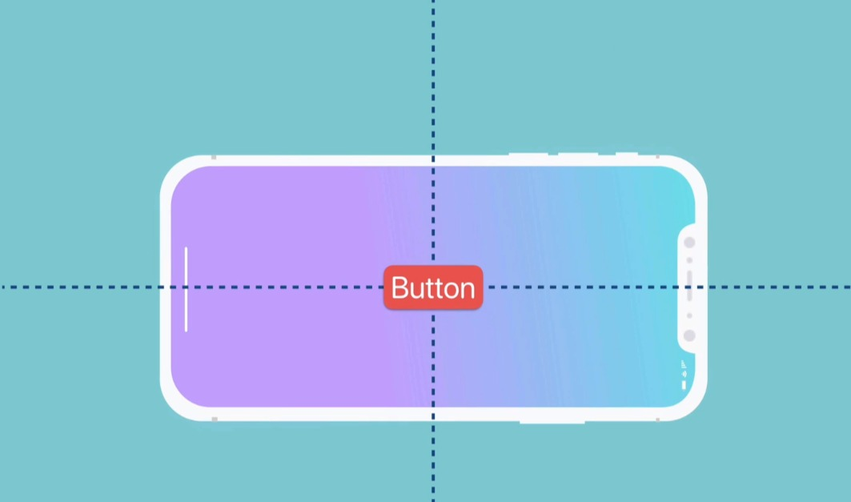
Pinning and Alignment
When our phone turns, the button is going to forever remain in the middle.

Slide 31
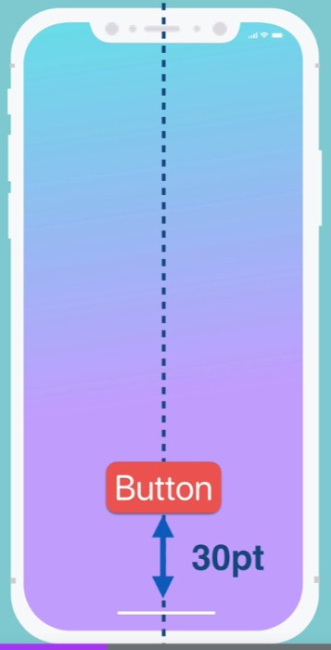
Pinning and Alignment
We can also use a combination of these two techniques where we say that our button needs to be in the horizontal center of the phone, but it also needs to be constrained so that it's always 30 points from the bottom of the safe area.

Slide 32
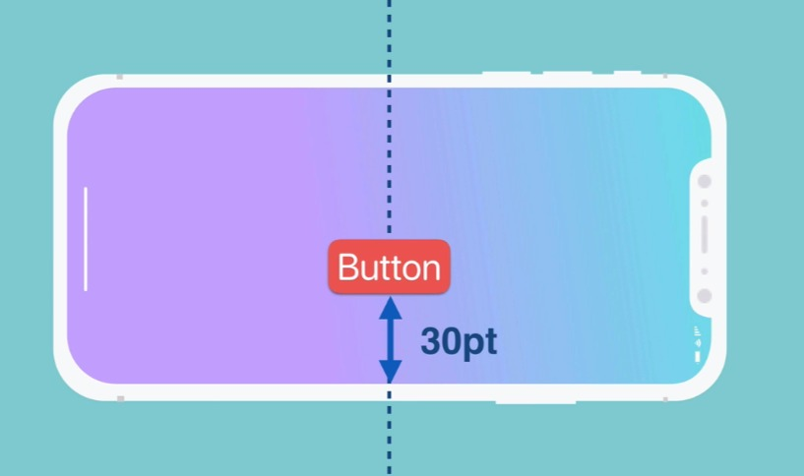
Pinning and Alignment
When our phone turns, it's going to keep all of those rules and it's going to look slightly different from before where it was just simply in the middle of the screen, but we're now using a combination of both alignments, which aligns to the center vertically or horizontally, as well as pinning, where we add a distance that our element needs to be from the edge of its containing view.

Slide 33
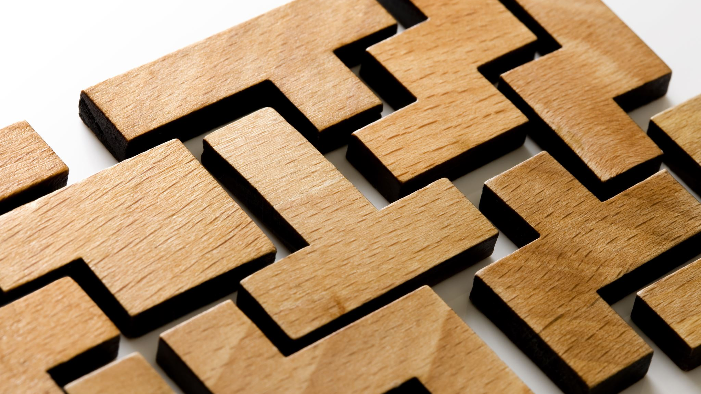
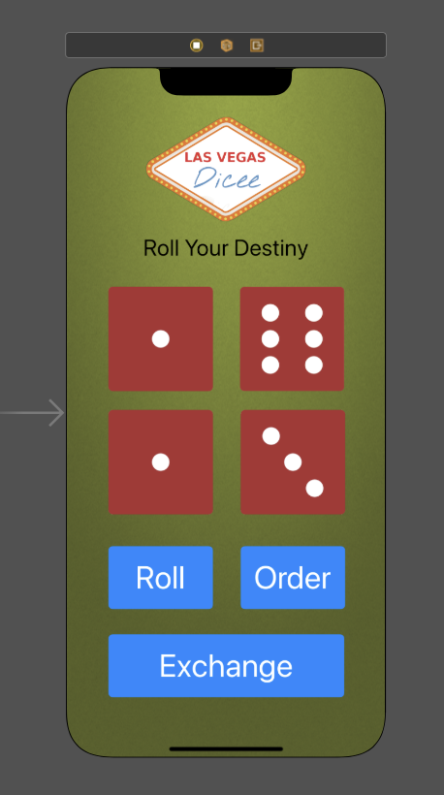
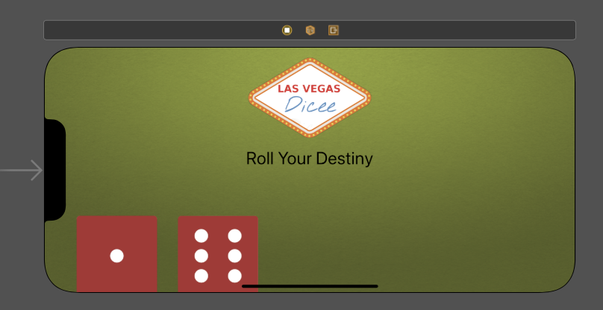
Challenge
Add some constraints to a new label to make it centered in the horizontal axis, but make sure it's also about 15 pixels below the dice logo even when we turn to landscape.

Slide 34
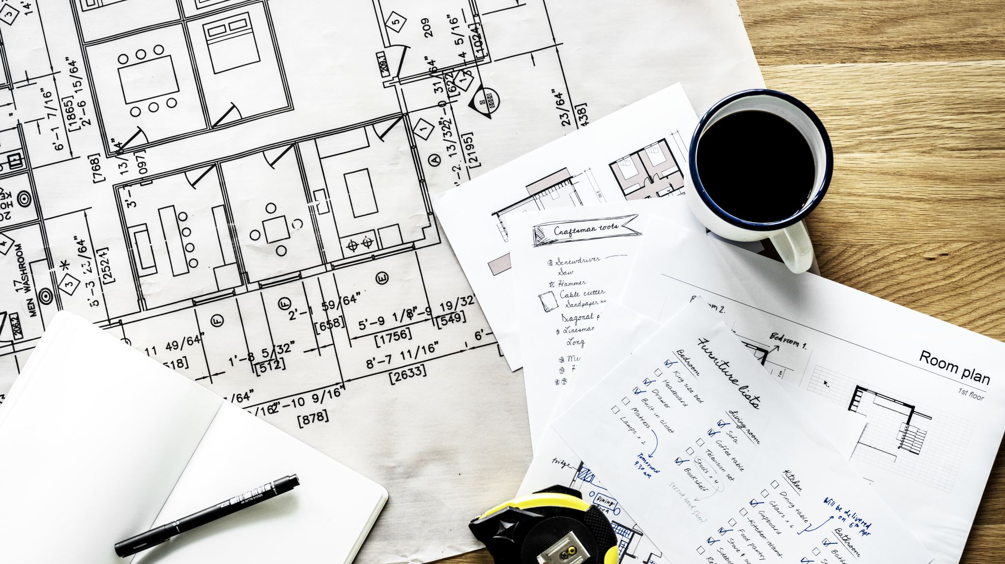
In the next lesson, we will see more complex layouts in our Main.storyboard using some of the things that we've learned, but also creating some containers to embed our elements in, so that we don't always have to align or pin it to the super view.

